Slide 1
Project 1: Speed Dating
Jonathan Bae, Haotian Li

Slide 2
Quick Glance
47% of American adult males over age 18 are single
Compared to men that speed date, women select half as many partners
Overall Goal: The objective of this study was to find what makes females decide yes to a male
Our findings show:
As a male, if you are attractive and funny, you will get the most yes
Notes:
http://www.census.gov/newsroom/facts-for-features/2015/cb15-ff19.html
http://www.nyeasydates.com/speed_dating_articles/want_to_try_speed_dating_consider_these_statistics.html

Slide 3
Data Cleaning
Predictors: Used men’s characteristics, events characteristics, and ratings for men
Classifier: Whether women partners said yes or no (dec_o)
Imputation:
If N/A rating for attributes attr_o, sinc_o, intel_o, fun_o, amb_o use mean score of the iid
If N/A coding for field_cd or career_c use code value similar corresponding careers and fields
Remove rows where no age or date preference values per iid
Change met values to either 1 (met previously) or 2 (have not previously)

Slide 4
Tree Model
Feature Selection:
Select following variables:
Used C5.0 tree and CTree
C5.0 has more branches

Slide 5
Classification (CTree)
Attractiveness and funniness always matter
Field and sincerity matter when you are attractive

Slide 7
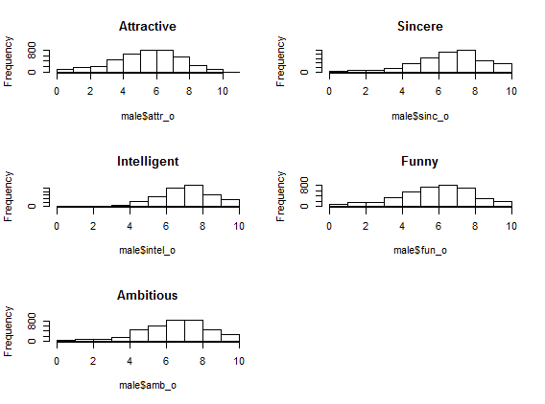
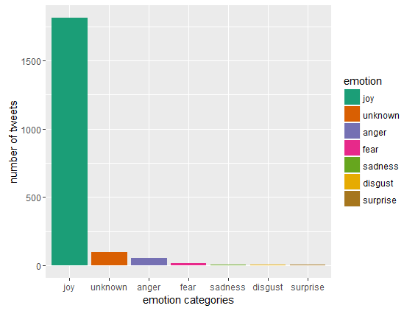
Ratings may be biased
Attractive has more normal distribution
Sentiment analysis for a related word “LOVE”:
People generally tweet the word “LOVE” with emotion joy

Slide 8
Conclusion
Final recommendation:
Be good looking
Be funny
Be more sincere if you are both
Further Research:
Find correlations between ratings and other attributes
Include education and income measurement

